Slide 1
REGENERATIVE BREAKING IN ELECTRIC VEHICALS.

Slide 2
PROBLEM STATEMENT
CONVENTIONAL BREAKING SYSTEM HAS FOLLLOWING DRAWBACKS:
ENERGY LOSS IN FORM OF HEAT WHILE BREAKING.
MORE WEAR AND TEAR OF BREAK PADS.
DRIVING RANGE IS LIMITED DUE TO LIMITED BATTERY CAPACITY.

Slide 3
SOLUTION: REGENERATIVE BREAKING
BY USING THIS METHOD OF BREAKING WE CAN ACHIEVE FOLLOWING THINGS:
WASTAGE OF ENERGY CAN BE REDUCE WHILE BREAKING.
WEAR AND TEAR OF BREAK PADS IS REDUCE.
DRIVING RANGE IS INCREASED.
A HUGE ADVANTAGE OF ELECTRIC VEHICLES IS THEIR ABILITY TO RECAPTURE KINETIC ENERGY AND STORE IT IN THE BATTERY.

Slide 4
WHAT IS REGENERATIVE BREAKING:
IN REGENERATIVE MODE OF BREAKING, THE MOTOR ACT AS A GENERATOR, IT TRANSFERS THE KINETIC TO ELECTRICAL ENERGY TO RESTORE THE BATTERIES OR CAPACITORS.
MEANWHILE, THE BRAKE CONTROLLER MONITORS THE SPEED OF THE WHEELS AND CALCULATES THE TORQUE REQUIRED PLUS THE EXCESSIVE ENERGY FROM THE ROTATIONAL FORCE THAT CAN BE CONVERTED INTO ELECTRICITY AND FED BACK INTO THE BATTERIES DURING REGENERATIVE MODE.

Slide 5
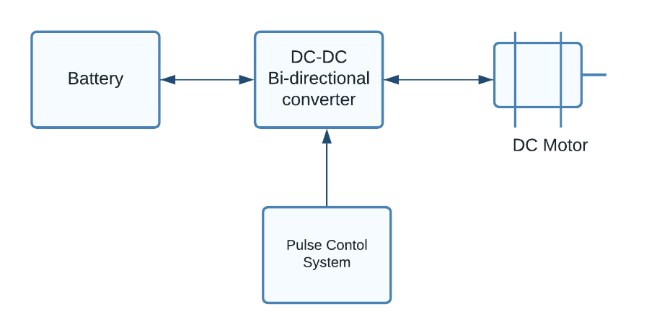
BASIC BLOCK DIAGRAM :

Slide 6
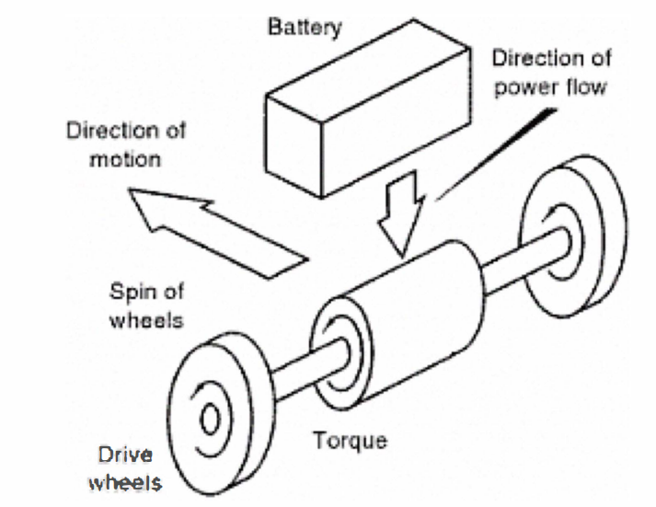
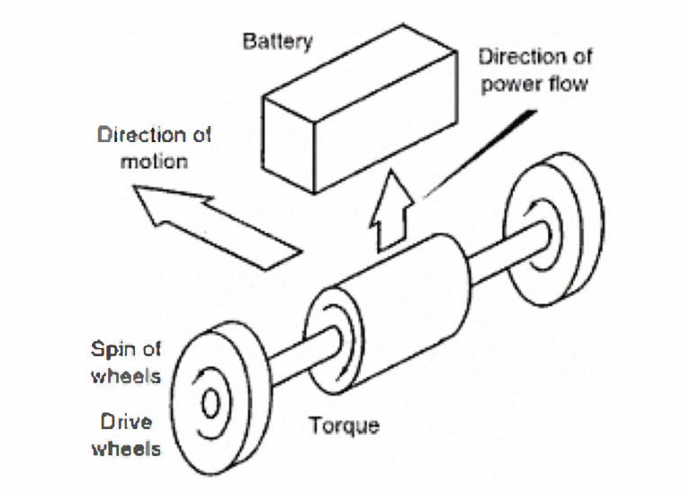
HOW REGENERATIVE BREAKING WORKS
MOTOR
MOTOR AS GENERATOR
NORMAL FORWARD DRIVING CONDITION
REGENERATIVE ACTION DURING BREAKING

Slide 7
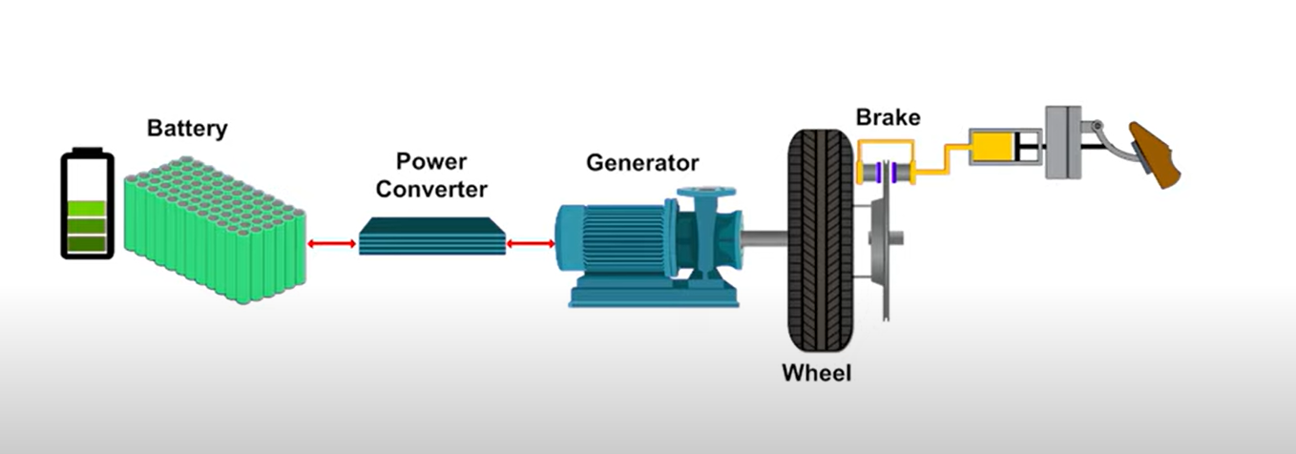
Actual Working
TO MAXIMIZE THE EFFICIENCY OF THIS PROCESS, THE DRIVELINE, POWER CONVERTERS, AND BATTERY DESIGN NEED TO BE COORDINATED WITH THE BATTERY MANAGEMENT ALGORITHM.

Slide 8
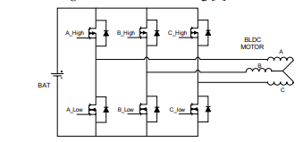
Power Converter

Slide 9
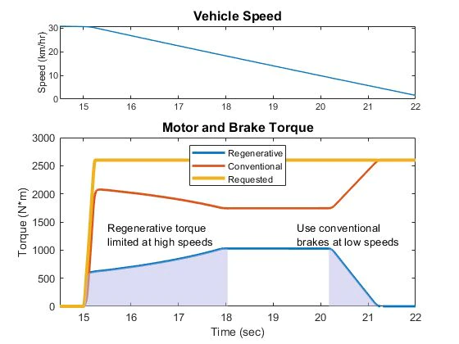
Graphical Representation
Hydraulic system and electric motors that generate torque during braking systems to balance requirements for passenger safety and comfort systems to balance requirements for passenger safety and comfort and to maximize the vehicle’s range.

Slide 10
LIMITATIONS:
WE CAN’T RELY ON ONLY THIS BREAKING SYSTEM FOR HIGH SPEED APPLICATIONS.
MORE EFFICIENT AND EFFECTIVE IN STOP-AND-GO DRIVING CONDITIONS.

Slide 11
Thank you

